Slide 1
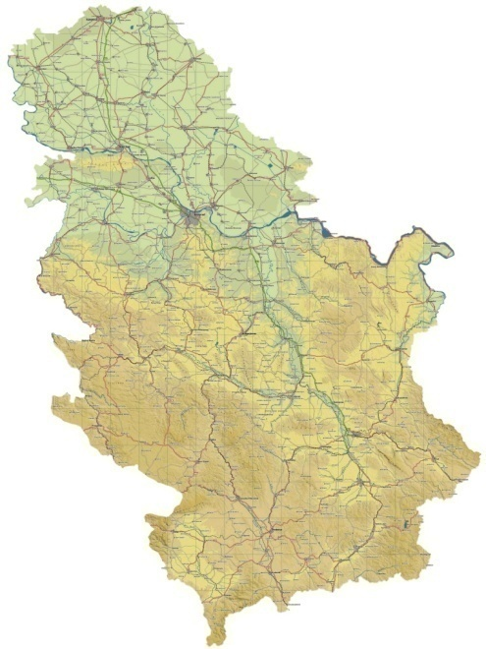
Lessons learnt
Biljana STOJANOVIĆ
Ministry of Education, Science and Technological Development

Slide 2
HOLOCAUST EDUCATION in SERBIA before 2008
Holocaust was taught as an integral part of few history lessons on WWII
Teachers spent very little time teaching the Holocaust
Students’ understanding of the Holocaust was that during WWII Jews were killed in concentration camps by Hitler
Students’ notion of Jews was that they were the people who killed Jesus Christ
They knew that Jerusalem is a holy city, and also a Christian city.
BUT

Slide 3
BUT
In 2006 in Budapest, Serbia became an observer country in ITF (IHRA)
From that time on, we have gone a long way through, but there is still much to be done
We established cooperation with many organizations such as: Yad Vashem, Centropa, Memorial de la Shoah, Anne Frank House, ODIHR and many more.
We are included in the Council of Europe’s Pestalozzi Program
We established a regional Balkan network of Holocaust educators in cooperation with the Holocaust Memorial Center for the Jews from Macedonia and with colleagues from Slovenia, Croatia, BH and Montenegro.
We established an excellent cooperation with the Jewish Community in Serbia.

Slide 4
LESSONS LEARNED
The Holocaust is a complex and sensitive topic which requires high level of teachers’ expertise.
The aim of teaching the Holocaust is not to teach/learn about 6 million victims without names and previous life.
The Holocaust can be taught
by implementing a variety
of approaches and methods.

Slide 5
LESSONS LEARNT
⇨Use different approaches for teaching the Holocaust, including the:
*student-centered approach
*cross-curricular approach
*interdisciplinary and multi-perspective approach
⇨Transform statistics into personal stories
⇨Be precise when using terminology and make sure students do the same.
⇨Encourage students to:
*use primary sources
*critically analyze different interpretations of the Holocaust
*study local, regional, national, and global history and memory
⇨Avoid teaching Jewish history entirely through the prism of the Holocaust.
⇨Select appropriate learning activities that avoid the use of simulations that encourage students’ identification with either the perpetrators, or the victims.

Slide 6
Serbia: Holocaust education contributes to
⇨the professional development of teachers (focused on student-centered AND interdisciplinary approach),
⇨teaching and learning process (based on analysis of films or written documents/ testimonies, research, learning when visiting monuments, museums, etc.),
⇨development of key competences (especially competences for understanding the responsibility of civil society, communication, cooperation).
It also contributes to the development of digital competences, learning to learn….

Slide 7
Serbia: Holocaust education contributes to
⇨acquire knowledge of Jewish history, Anti-Semitism and the Holocaust (especially among students whose teachers are involved in this program)
⇨develop multi-perspective and interdisciplinary approaches
⇨identify and develop critical analysis of stereotypes, old-fashioned attitudes and interpretations,
⇨break prejudices about others and stereotypes about themselves
⇨intercultural dialogue.

Slide 8
Important changes
The Holocaust, as a curriculum topic is focused on:
*developing knowledge about human rights, and prevention of crimes against humanity
*developing skills to recognize the consequences of stereotypes, prejudices, racism, anti-Semitism and all other forms of discrimination
*developing attitudes
*nurturing culture of remembrance
Learning about the Holocaust is learning about Jewish life before, during and after Holocaust and the stories of individuals who had names, hopes and needs.

Slide 9
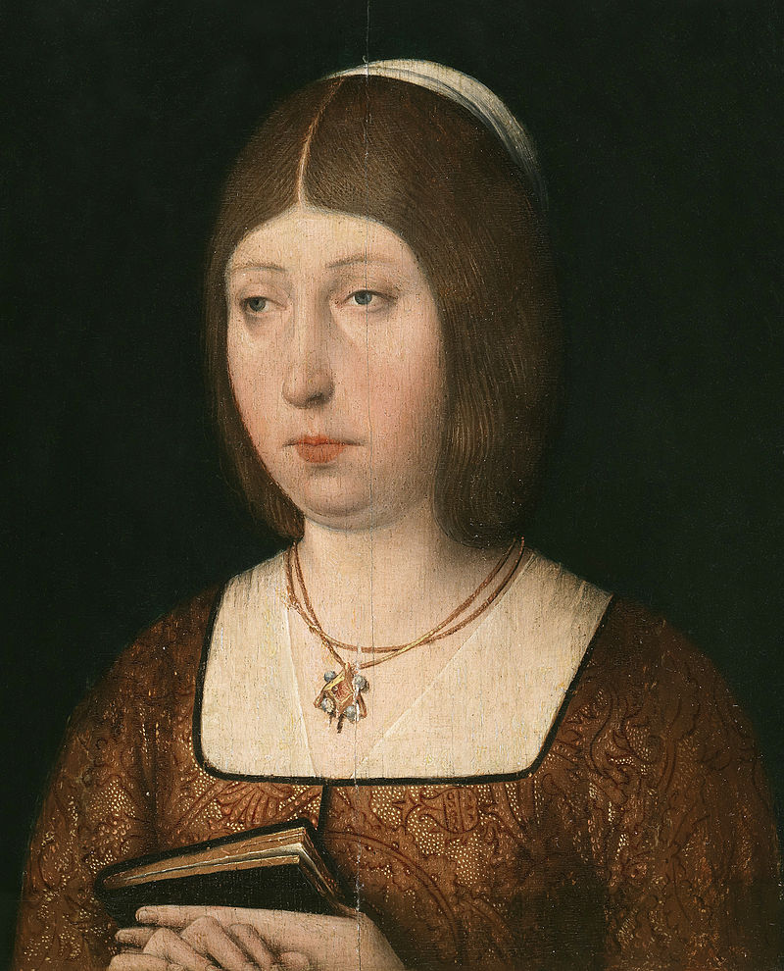
Examples
Questions for students
Do you know who the woman in the picture is?
When and where did she live?
What is she known about?
Can you explain the connection between her and the Jews?

Slide 10
Examples
USING FILMS
El Otro Camino
When can we use this film?
When students learn about The Age of Discovery . The history teacher explains the actions of Queen Isabella related to the exile of the Jews, and those related to Columbus.
ACTIVITIES:
Students watch the first part of the film.
Discussion about the Jews and why they had to leave Spain.
Students try to find the answers to the following questions:
*Where did the exiled Jews settle?
*What did they use to do for living?
*Which were the professions they brought about in their new home towns?
PROJECT activities/ HOMEWORK:
*Do research in your town to find Jewish families whose origin is from Spain.
*Write questions for an interview with such a family.

Slide 11
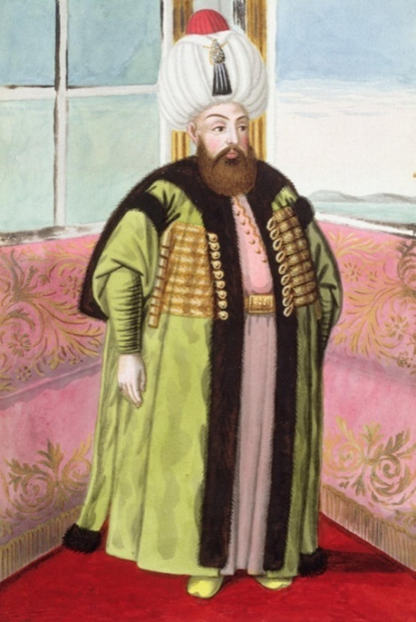
Examples
New activities:
1. Students watch Centropa film Three promises (few sequences from the beginning of the second part of the film) and after that they watch the film My Spanish Bosnian Life (the introductory part of the film).
2. Students research the period
of the Jewish settlement in the Balkans
and they make PPP.
3. Students present their PPP focusing on
their research results.

Slide 12
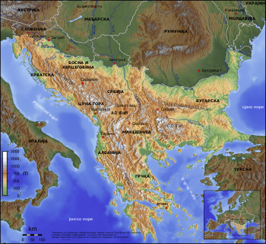
Examples
New activity:
On the contemporary geographical map of the Balkans, the students mark the places the exiled Spanish Jews settled in, and then identify the countries these places belong to today.
(Geography teacher included).

Slide 13
Examples
Final activity:
Students make their own exhibition about Balkan Jewish history from XV to XX century.
In this way the teacher enables students to continuously study Balkan Jewish history and also integrate Balkan history within the framework of European history.
Students acquire knowledge, skills and attitudes (competencies) during the research process.

Slide 14
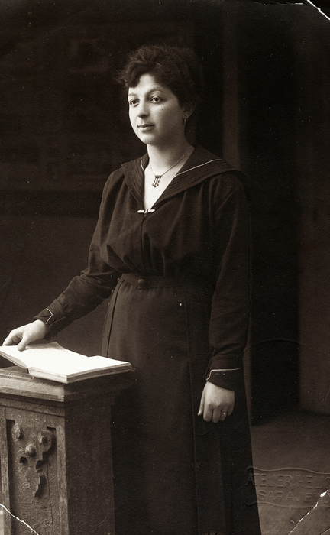
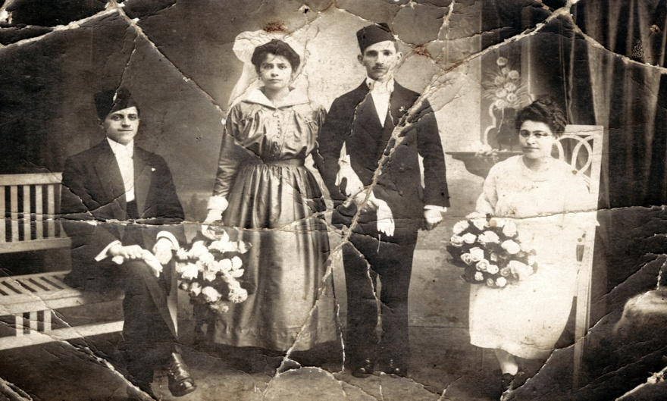
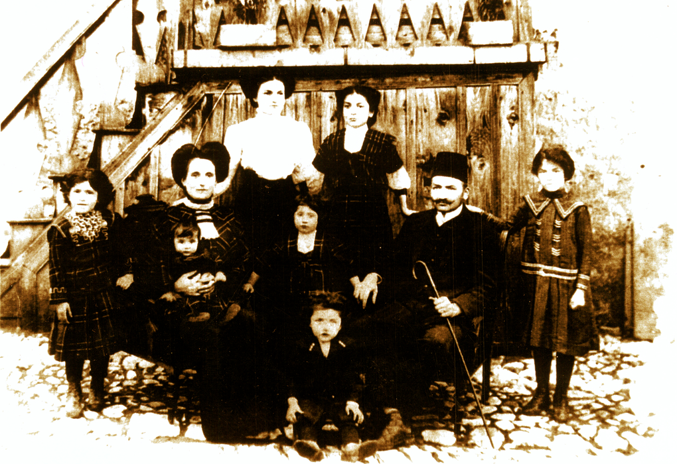
Examples
Centropa web site offers an enormous database of interviews and old family photos. Centropa movies are based on the interviews and the old family photos. All the interviews are translated in English.

Slide 15
Examples
Theme: Everyday Jewish family life in the Kingdom of Yugoslavia - based on Centropa interviews and old family photos.
Cross-curricular project by an integration of the following subjects: Civic Education, History, English and Geography.
Interdisciplinary/integrated approach.
Participatory and cooperative methods.

Slide 16

AND
CENTROPA website offers a variety of teaching/learning material.
The teaching material has universal implications and is easily accessible.
The variety of materials and topics enables students develop diverse competencies and contributes to their preparation to live in the contemporary society.

Slide 17
AND FOR THE END
THANK YOU FOR YOUR ATTENTION.

