Slide 1
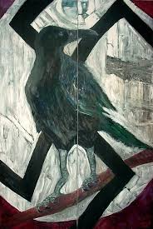
The Prejudice of Jim Crow and the Holocaust
CENTROPA Project
by
Illijan Kuzmanovic
Jeffrey Renihan
Modified from a presentation by Mitchell Bloomer

Slide 2
The Quiz!
Members of the minority group are not allowed to be teachers in the public schools.
Nazi Germany
Marriages between a member of the majority group and a person of the minority group or of minority descent to the fourth generation inclusive are forbidden.
U.S. - Florida
The number of students from the minority group allowed in public school is restricted to the minority group’s percentage in the general population.
Nazi Germany
Members of the minority group are not allowed to buy lottery tickets.
Nazi Germany
Blind members of the minority group will be admitted, housed, cared for, and instructed in different facilities from blind members of the majority group.
U.S. - Louisiana

Slide 3
The Quiz!
Members of the minority group are not allowed to be civil servants.
Nazi Germany
Members of the majority and minority groups may not be served food in the same establishment unless their respective seating areas are separated by a solid partition at least seven feet in height.
U.S. - Alabama
Separate telephone booths may be required for members of the majority group and members of the minority group in any locality upon receipt of complaints.
U.S. - Oklahoma
Anyone found guilty of printing, publishing, or circulating materials advocating social equality may be fined and/or imprisoned.
U.S. - Mississippi
Members of the minority group are not citizens of the nation, nor may they exercise the right to vote.
Nazi Germany

Slide 4
Cornell Notes

Slide 5
Black Codes – the precursor to Jim Crow Laws
Beginning immediately after the American Civil War (1865), Black Codes were attempts by Southern States to continue the suppression of Black freedmen.
Vagrancy was deemed to be illegal in almost all Black Codes and convictions would result in a term of hard labor, essentially a new form of slavery.
Marriage between whites and blacks was illegal.
Voting was limited to white males.
Black servants’ contracts often made it illegal for them to quit before their contract was over.

Slide 6
America’s Segregation Timeline
1865-1866: Black Codes are instituted in the Southern States.
July 9th 1868: 14th Amendment adopted guarantying the right to vote to all males age 21 and older, regardless of race, as well as equal status to males of all race under the law.
1868: Most states’ Black Codes have been repealed.
1877: Northern interest in the rights of freedmen has waned.
The Jim Crow Era begins.
1890’s: Jim Crow Laws bring de jure segregation continues across South.
1910: Southern States have excluded blacks from voting.

Slide 7
Jim Crow Laws
These laws were common throughout the South and as far west as Wyoming and as far north as Maryland.
They banned and nullified interracial marriages.
They segregated nearly all public places, from cafes and wineries to schools and public bathrooms.
Blacks were often allowed no or restricted interaction with white females, while whites of both sexes were allowed to refuse interaction or services to blacks.

Slide 8
Jim Crow Laws
Through a mix of poll taxes, literacy tests, and grandfather clause blacks are almost universally denied the right to vote.
This is in spite of the 14th Amendment, the entire purpose of which was to protect against racist voting practices such as these.

Slide 9
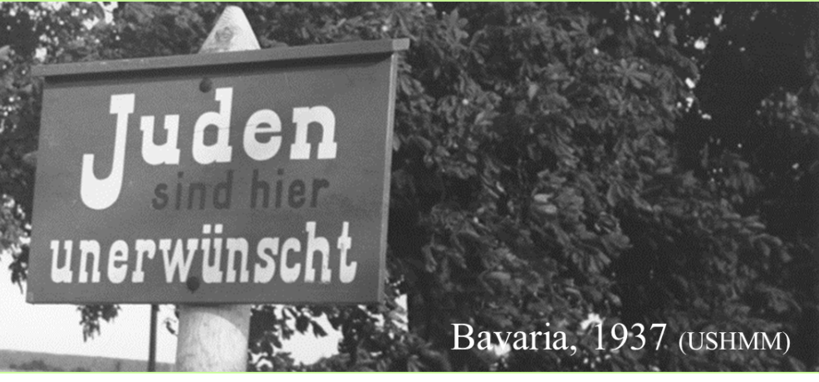
The Four Stages of the Holocaust:
Segregation of Jews within Germany / Removal of Jewish influence: 1933-1936+

Slide 10
Joseph Goebbels speaking about Jews in Germany - September, 1935
“One should not let them into every public swimming resort… We have up there on the Baltic Sea, let’s say one hundred resorts, and into one of them will go the Jews… It should not be the nicest resort, but maybe the worst of those we have, that we will give them – and in the others, we’ll be among ourselves. That I consider right. We cannot push the Jews away, they are here. We do not have any island to which we could transport them. We have to take this into account…”
Quotation from: Nazi Germany and the Jews : The Years of Persecution, 1933-1939 Volume I , page 143
Saul Friedlander
Compare and contrast this first stage with segregation in America?

Slide 11
The Four Stages of the Holocaust:
Segregation of Jews within Germany / Removal of Jewish influence: 1933-1936+
Coerced Emigration: 1937-1939
Expulsion: 1939-1941
Mass Killing and Genocide (Final Solution): 1941-1945

Slide 12
Experiencing the Four Stages of the Holocaust Complete the Sound Recording Analysis Worksheet while Listening
http://www.centropa.org/centropa-cinema/rosa-rosenstein-living-history?subtitle_language=

Slide 13
http://www.archives.gov/education/lessons/worksheets/

Slide 14
Experiencing the Four Stages of the Holocaust Complete the Sound Recording Analysis Worksheet while Listening
http://www.centropa.org/centropa-cinema/rosa-rosenstein-living-history?subtitle_language=

Slide 15
The Four Stages of the Holocaust:
What is the relationship between each of the stages of the Holocaust?

Slide 16
The Nuremberg Laws - 1935
Reich Citizenship Law
Only a person of German or related blood can be a Reich citizen
Only Reich citizens have full political rights under the law
German Jews are thus deprived of citizenship

Slide 17
The Nuremberg Laws - 1935
Laws for the Protection of German Blood and German Honor
Marriage / intercourse forbidden between Jews and Germans
Jews may not employ German women under the age of 45 in their homes
Jews may not fly the German flag, but may display Jewish colors

Slide 18
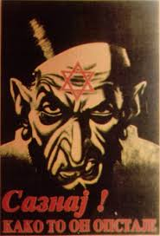
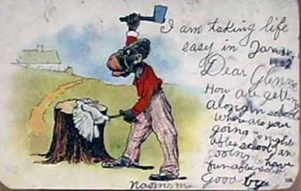
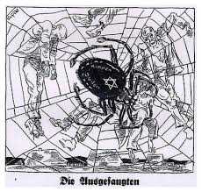
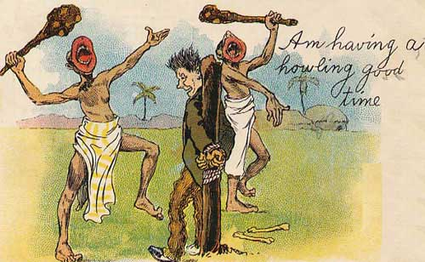
The Dehumanization of the Minorities
Notice the similarities in the over-exaggerated features and attempts to make the target animalistic.

Slide 19
The Dehumanization of the Minorities
Analyze one political cartoon about the Nuremburg Laws using the cartoon analysis worksheet.

Slide 21
The Dehumanization of the Minorities
Analyze one political cartoon about the Nuremburg Laws using the cartoon analysis worksheet.

Slide 22
The Dehumanization of the Minorities
Analyze one political cartoon about the Jim Crow Laws using the cartoon analysis worksheet.

Slide 24
The Dehumanization of the Minorities
Analyze one political cartoon about the Jim Crow Laws using the cartoon analysis worksheet.

Slide 25
The Dehumanization of the Minorities
Compare the two cartoons you analyzed. Identify the similiarities.

Slide 26
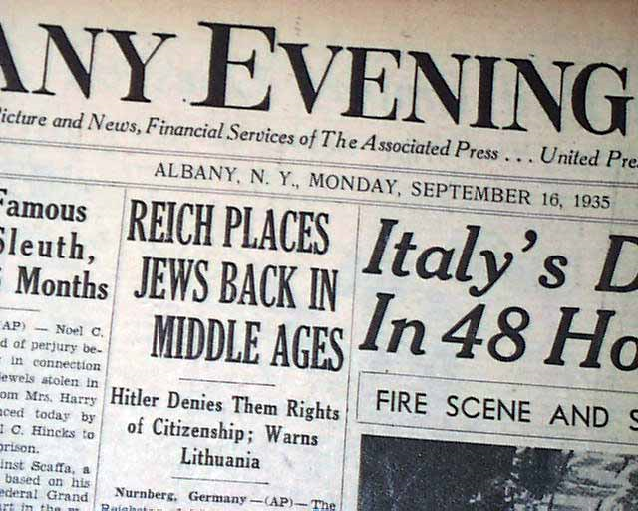
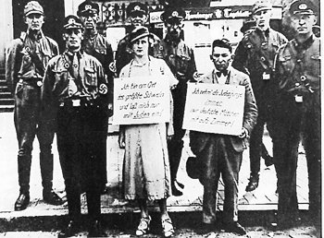
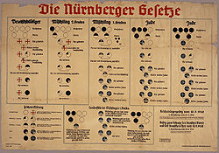
Middle Ages?
Let’s Discuss

Slide 27
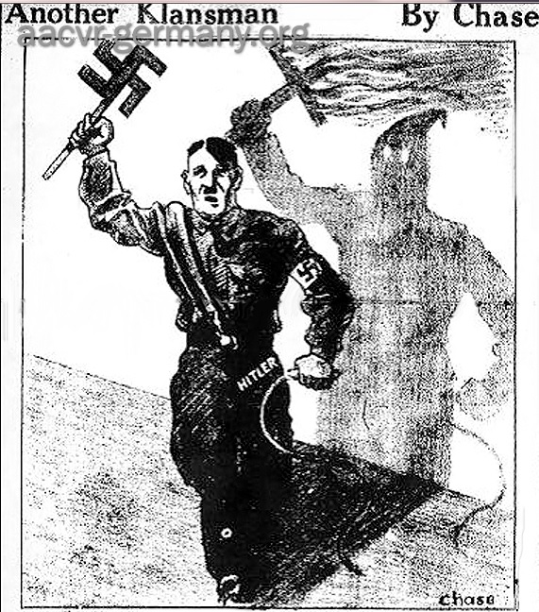
Did Americans see the connection? Discuss with your shoulder partner – then think, pair, share

Slide 28
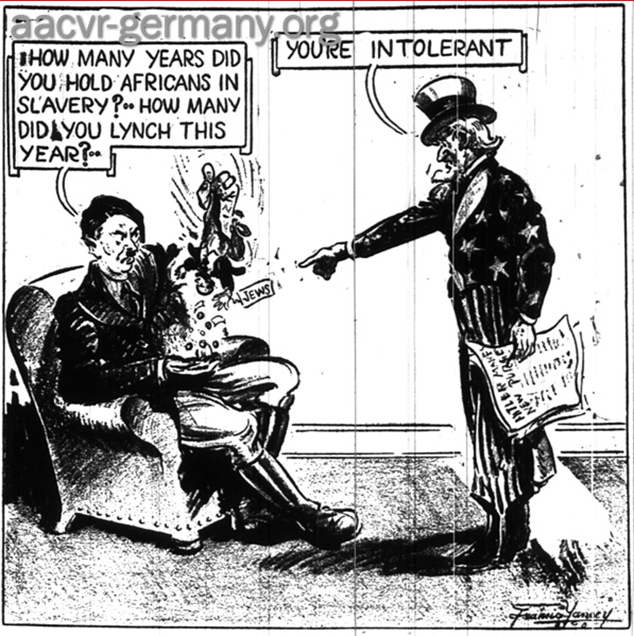
Did Americans see the connection? Discuss with your face partner – think, pair, share

Slide 29
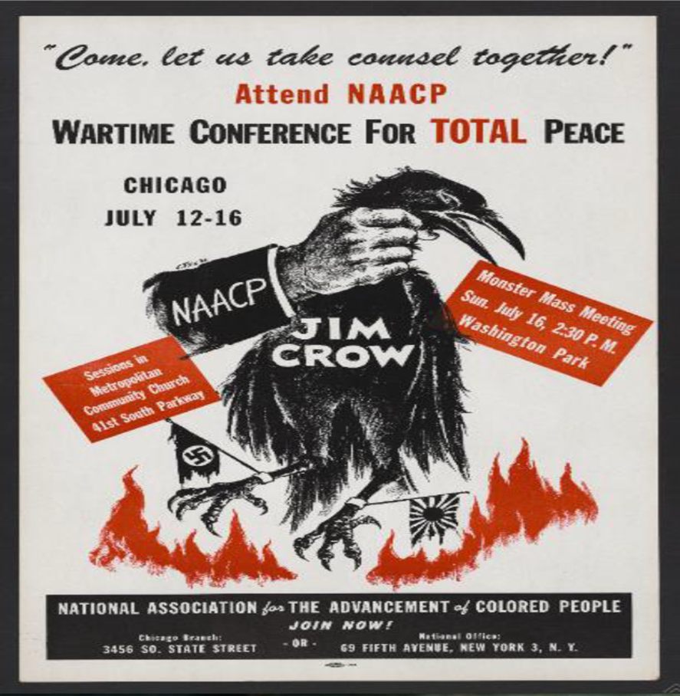
Did Americans see the connection? Use the Poster Analysis Worksheet to Determine your Response

Slide 31
Did Americans see the connection? Use the Poster Analysis Worksheet to Determine your Response

Slide 32
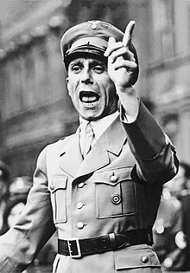
Did Germans see the connection?
“The Third Reich has been the target of its mockery, hatred, lies, and slander since 30 January 1933, especially from that part controlled by the Jews. The American press takes particular pleasure in criticizing Germany on grounds of humanitarianism, civilization, human rights, and culture. It has every right to do so. Its humanity is shown in most vivid form by lynchings.”
Joseph Goebbels
21 January 1939
In your notes, write who you think the author is referring to in the quote? Based on what you have learned in this presentation, do you agree or disagree? Use evidence to defend your response.

Slide 33
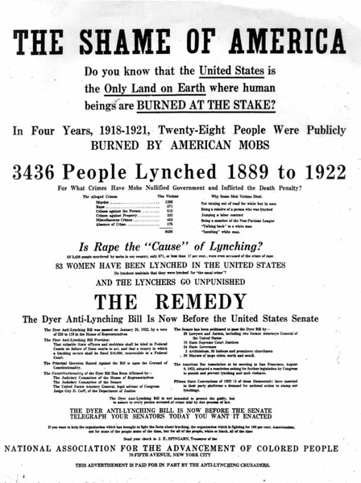
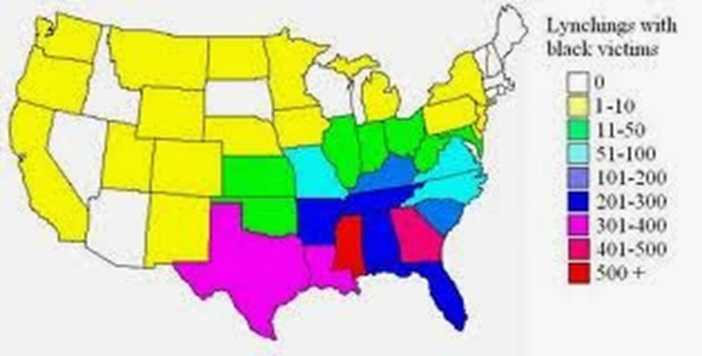
The Reality of Life for Colored People In the United States

Slide 34
From before World War II to the Twenty-first Century

Slide 35
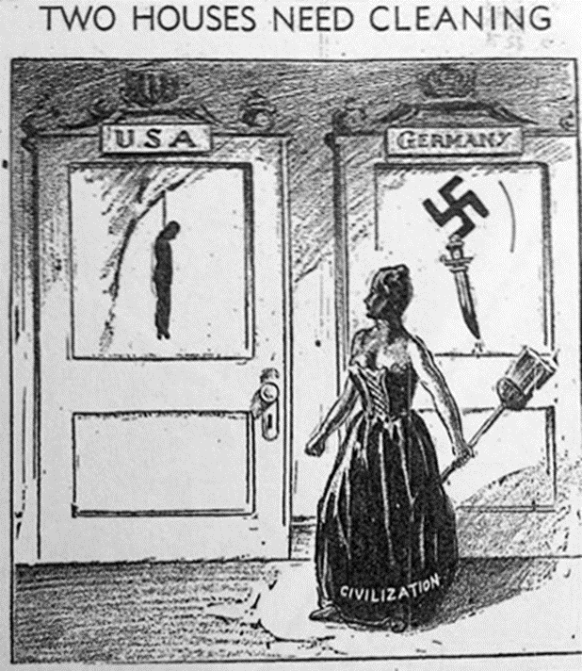
Writing Prompt: How much does our house still need cleaning? Use evidence from your notes and worksheets to support your response.
Jim Crows and Nuremburg Laws are history.
Many laws have brought an end to the era of de jure segregation in the United States of America and Europe.

